Slide 1
Meeting Simulation Offering
Add a brief explanation of the presentation’s purpose

Slide 2
Often Executives focus on the outcome of the meeting, other than key contributing factors and behaviours, it is often very difficult to explore how a decision was made
Where boards adopt a “collective responsibility” approach, where the policy is that a decision once made is then supported by everyone this reduces the ability to understand if the decision made was even correct

Slide 3
A multi-agent conversational simulation of meetings, where each agent is an LLM agent with a persona, objectives, constraints, and behavioral heuristics. The meeting proceeds as a “round table” interaction, and generates a transcript of discourse, decisions, interruptions, proposals, follow-ups, etc. From which behaviours, paths, outcomes and trajectories can be analysed
Agent based, Large Language Model for simulating interacting actors
Conversation / Interaction Models (turn taking, repair, adjancy pairs, interuptios) to shape dialogue
Agent personality modelling differences, social influences, power, convrersational dominance, face-saving
Decision making to define what is a good meeting outcome

Slide 4
Features 1
Stage | Key Tasks / Decisions | Risks & Mitigations
Persona & Agent Specification | • Define roles (e.g. Chair, Tech Lead, Finance, HR). • For each persona: goals, information, personality traits (e.g. assertiveness, cooperativeness, status), biases, knowledge. • Define strategies (e.g. speak early, build alliances, accept consensus, block proposals). | Overfitting or oversimplification of personas. Mitigate via empirical calibration from real meeting data.
Conversation/Interaction Protocol | • Turn-taking policy: when an agent can “take the floor,” interrupt, yield, or request turn. • Agenda structure: phases (opening, topic discussion, evaluation, decision). • Repair, clarifications, side sequences. • Interruptions, overlaps. | Agents might degenerate into chaotic interrupting. Use constraints (e.g. maximum interruptions per minute) or “social norms” heuristics.
Behavioral Heuristics / Decision Rules | • Based on theoretical models: e.g. agent will propose solution when perceived utility > threshold, will support others’ proposals if aligned, will resist proposals conflicting with goals. • Use weights: e.g., risk aversion, desire to dominate, face concerns. • Agents can “react” (accept, defer, counter) based on utilities. | Behavior may be rigid or brittle. Include randomness or learning. Possibly allow agents to adapt during simulation.
LLM Integration (Natural Language Layer) | • The high-level heuristics decide what an agent wants to say / do; the LLM “verbalizes” it in natural language. • The LLM also interprets others’ utterances (natural language understanding) to update beliefs, detect proposals, conflicts, cues. • Use prompt engineering + partial memory / context windows. | Hallucination or misinterpretation. Use constrained prompt templates and verification steps (e.g. parse utterances into structured representations and feed those into decision heuristics).

Slide 5
Features 2
Stage | Key Tasks / Decisions | Risks & Mitigations
Logging & Analytic Instrumentation | • Record full transcripts, annotated with turn metadata (speaker, time, overlap, interruptions). • Extract structured events: “proposal made,” “vote,” “objection,” “support,” “silence after objection,” etc. • Track trajectories: who spoke when, who responded, how proposals evolved. | Data overload. Choose a schema in advance (e.g. based on IPA categories + meeting decision events).
Outcome & Metrics Definition | • Define “good” vs “bad” outcomes (e.g. decision quality, consensus, stakeholder satisfaction, time efficiency, fairness). • Metrics: decision speed, number of proposals, disagreement ratio, participation equality (Gini over speech turns), dominance index. • Qualitative outputs: transcript excerpts, decision tree trace, alternative scenario traces. | The “correctness” of outcome is somewhat subjective. Use multiple metrics and allow domain tailoring.
Validation & Calibration | • Compare simulation traces with data from real meetings (e.g. in organizations) to calibrate parameters. • Run sensitivity analysis: vary agent traits, heuristics, opening moves, and see how outcomes change. • Use expert judges to evaluate whether simulated interactions “feel realistic.” | If simulation diverges too far from real meetings, it may be pedagogically misleading. Iterative tuning is vital.
Educational / Exploratory Interface | • UI to let a human user “join” or “intervene”: e.g. “What if I had asked the question earlier?” • Scenario branching: run multiple possible meeting paths given small behavioral changes. • Post-mortem inspector: annotate where key turning points occurred, who overpowered whom, etc. | Complexity and usability tradeoffs. Focus initially on a small set of scenarios and make the interface clean.

Slide 6
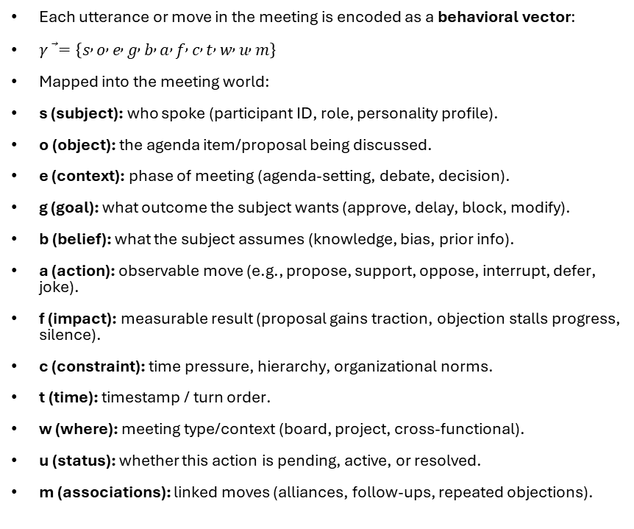
Utterances and behaviours
Each utterance or move in the meeting is encoded as a behavioral vector:
$γ\text{⃗}=\left\{s , o , e , g , b , a , f , c , t , w , u , m\right\}$
Mapped into the meeting world:
s (subject): who spoke (participant ID, role, personality profile).
o (object): the agenda item/proposal being discussed.
e (context): phase of meeting (agenda-setting, debate, decision).
g (goal): what outcome the subject wants (approve, delay, block, modify).
b (belief): what the subject assumes (knowledge, bias, prior info).
a (action): observable move (e.g., propose, support, oppose, interrupt, defer, joke).
f (impact): measurable result (proposal gains traction, objection stalls progress, silence).
c (constraint): time pressure, hierarchy, organizational norms.
t (time): timestamp / turn order.
w (where): meeting type/context (board, project, cross-functional).
u (status): whether this action is pending, active, or resolved.
m (associations): linked moves (alliances, follow-ups, repeated objections).
Each LLM-based participant can be given:
Role attributes: Chair, expert, skeptic, supporter.
Behavioral goals (g): What they want from the meeting.
Beliefs (b): Knowledge, assumptions, biases.
Behavioral repertoire (a): Allowed actions based on role (e.g., Chair can “summarize & close,” others cannot).
Constraints (c): Time budget, seniority, cultural norms.
When an LLM agent takes a turn, you:
Decide behavior vector values (γ⃗) based on persona + context.
Generate utterance from γ⃗ using the LLM (“express support for this proposal in cautious, deferential language”).
Update state of meeting (decisions, alliances, time, participation balance).
Because every utterance is a γ⃗, you can track behavioral mechanics:
Coalition building: multiple γ⃗ with the same {o, g, a=support}.
Obstruction: γ⃗ with {a=oppose} → delays or stalls agenda.
Dominance: repeated {a=interrupt} from the same subject.
Deference/silence: gaps in γ⃗ from certain participants.
Momentum shifts: impact (f) accumulates toward acceptance or rejection.
This lets you see not just the words, but the mechanics of power and persuasion.

Slide 7
Turning taking
Talk is organized in turns
Conversations are built turn by turn.
A “turn” = one participant’s talk until another takes over.
Turn Construction Units (TCUs)
The smallest unit that can form a complete turn (can be a word, phrase, or sentence).
Listeners anticipate possible completion points.
Transition Relevance Places (TRPs)
Natural points where a speaker’s turn could end.
Others may self-select to speak, or the current speaker may select the next.
Rules of Turn Allocation
If current speaker selects the next → that person has right to speak.
If no one is selected → anyone may self-select.
If no one self-selects → current speaker may continue.
Overlap & Interruption
Overlaps happen at TRPs (normal, often cooperative).
Interruptions = violations of turn norms, often signaling power/dominance.
Repair Mechanisms
Speakers fix misunderstandings, errors, or mishearings in real time.
Can be self-initiated or other-initiated.

Slide 8
Interaction Process Analysis (Bale)
1. Socio-Emotional (Positive)
IPA Category | Prompt Template | Prompt Template | γ⃗ Mapping | Expected Impact (f)
Solidarity | “Express strong support for [o] and validate [s_prev]’s contribution.” | “Express strong support for [o] and validate [s_prev]’s contribution.” | {a: support, o: agenda item, m: link to prior move} | ↑ cohesion, ↑ coalition strength
Tension Release | “Lighten the mood with humor or reassurance before returning to topic.” | “Lighten the mood with humor or reassurance before returning to topic.” | {a: tension-release, e: context, c: social norms} | ↓ tension, ↑ group morale
Agreement | “State agreement with [o] or [s_prev] and briefly justify why.” | “State agreement with [o] or [s_prev] and briefly justify why.” | {a: agree, o: proposal, m: coalition} | ↑ proposal momentum, alignment
2. Task-Oriented (Attempted Answers)
IPA Category | Prompt Template |  | γ⃗ Mapping | Expected Impact (f)
Suggestion | “Propose a concrete action or path forward on [o].” |  | {a: propose, o: agenda item, g: decision} | Creates new option, drives task progress
Opinion | “Offer an evaluation of [o], highlighting pros/cons.” |  | {a: opinion, b: belief} | Frames perception, shifts beliefs
Orientation (info) | “Clarify or restate key facts about [o] for the group.” |  | {a: inform, b: knowledge} | ↓ ambiguity, ↑ shared mental model
3. Task-Oriented (Questions)
IPA Category | Prompt Template |  | γ⃗ Mapping | Expected Impact (f)
Ask for Orientation | “Request specific facts or clarification about [o].” |  | {a: ask-info, o: agenda item, b: missing data} | Triggers info sharing
Ask for Opinion | “Invite another participant’s evaluation or values on [o].” |  | {a: ask-opinion, m: directed to s_target} | Surfaces beliefs, engages group
Ask for Suggestion | “Ask for alternative actions or next steps on [o].” |  | {a: ask-suggestion, g: explore options} | Generates options, spurs creativity
4. Socio-Emotional (Negative)
IPA Category | Prompt Template |  | γ⃗ Mapping | Expected Impact (f)
Disagreement | “State opposition to [o] and explain your reasoning.” |  | {a: oppose, o: agenda item, m: linked to proposal} | ↓ momentum, ↑ conflict
Tension (strain) | “Express frustration, stress, or difficulty with the discussion.” |  | {a: tension, c: constraints, e: context} | Signals overload, may stall group
Antagonism | “Challenge [s_prev]’s credibility or dismiss their point.” |  | {a: antagonize, m: escalation} | ↑ conflict, ↓ cohesion
“talking at each other” with little inquiry
Emotion Positive
Task Answers
Task Questions
Emotion Negative
destructive conflict.
Every utterance → γ⃗ vector.
Example: “I disagree, this is too risky.”
→ {s: P2, o: Proposal X, a: oppose, b: assumption of risk, f: conflict escalation}
→ Quadrant 4 (Socio-Emotional Negative).
Aggregate over time → quadrant heatmap.
Ratio of Task vs. Socio-Emotional
Ratio of Positive vs. Negative
Individual participant distributions
Diagnose meeting health.
Balanced meetings show activity in all four quadrants.
Dysfunction shows quadrant dominance (e.g., too much Q4 conflict, or only Q2 statements without Q3 inquiry).

Slide 9
Meetings are supposed to help groups make high-quality decisions
Problem Analysis
Define the issue clearly.
Gather relevant facts, clarify goals, identify constraints.
Coded in your γ⃗ as: subject = group, object = agenda item, belief = shared understanding.
Criteria Development
Establish standards for evaluating solutions.
What counts as “good” or “acceptable”? (cost, fairness, feasibility, speed).
Generation of Solutions
Brainstorming alternatives.
Encourage diversity of perspectives, reduce premature convergence.
IPA quadrant focus: Task – Asking + Task – Giving.
Evaluation of Solutions
Weigh pros and cons against criteria.
Challenge assumptions, test feasibility.
Both positive and negative socio-emotional behaviors may surface here.
Selection / Consensus / Implementation Planning
Decide on the best alternative.
Achieve buy-in (consensus vs majority vs leader-decided).
Develop action plan (who does what, when).

Slide 10
Use Cases
Role vs Strategy Variation
Hold persona constant but vary the strategic profile (e.g. more aggressive vs more collaborative) and see how that shifts outcomes.
Intervention Testing
Insert “best practice prompts” (e.g. “pause and invite quieter voices”) mid-simulation and see how meeting dynamics change.
Training Scenarios
Let a human participant enter as one agent and play out the rest via simulation; after, show them alternative trajectories.
Policy / Design Exploration
Use simulation to test meeting design choices: e.g. shorter durations, fixed speaking order, pre-meeting priming, anonymity, pre-distributed proposals.
Path Dependence & Tipping Points
Run parallel simulations with slight perturbations early (e.g. who speaks first) and observe divergence in outcomes.

Slide 11
Considerations
Hallucination & Incoherence
LLM agents may drift off-topic or produce implausible behavior. You’ll need constraints, structured prompts, and fallback logic.
Simplification / Overshadowing of Human Complexity
Real humans have emotions, fatigue, implicit biases, nonverbal cues, micro-expressions — simulating all of that is extremely hard. Don’t oversell realism.
Validation / Calibration Difficulty
Getting real meeting transcripts and annotating them is labor-intensive. Yet it’s crucial for realistic simulation.
Scalability & Divergence
As you increase agent count or complexity, behavior might become chaotic or degenerate. You’ll need sanity checks, constraints, and agendas to keep coherence.
User Adoption / Interpretability
If the simulation’s inner logic is opaque, users may mistrust the outputs. Providing interpretability (why an agent acted so) is key.
Ethical / Misuse Risks
Because the system can simulate influence or persuasion strategies, it might be used manipulatively. Be clear about intended boundaries (e.g. for educational use only).

Slide 12
Theoretical Anchors and Research
Functional Group Communication / Meeting Science
The standard view of what functions a meeting should serve (problem definition, solution generation, evaluation, consensus, plan). Use that as a scaffold for agents’ behavior (i.e. they know which “stage” they are in).
Conversation Analysis / Turn-taking Theory
Use models from Sacks, Schegloff, Jefferson, etc. regarding how turns are allocated, how overlap is repaired, how interruptions function as shifts in power.
Interaction Process Analysis (Bales)
For coding and categorizing utterances into task vs socio-emotional contributions — useful both in simulation and in annotating simulated transcripts.
Leadership Behavior in Meetings
There is research on what leader behaviors facilitate effective meetings (e.g. in staff meetings) Cambridge University Press & Assessment. Use that to shape how “chair” agents behave (e.g. how to intervene, refocus, manage digressions).
Proactivity / Reactive Behavior in Meetings
Some recent studies examine how proactive proposals or interventions influence patterns, and how reactions (supportive vs critical) moderate outcomes. SpringerLink
Personality / Trait Effects on Meeting Behavior
There is literature on how personality traits (e.g. extraversion, dominance, agreeableness) correlate with meeting conduct, interruptions, persuasion, etc. digitalcommons.unomaha.edu
Behavior Informatics / Behavior Simulation Theory
Use frameworks such as Behavior Informatics to model, simulate, and analyze behavior at scale, enabling richer pattern discovery and behavioral trajectories. arXiv
Agent-based Social Simulation / Social Science Multi-agent Models
The broader field of agent-based social simulation gives you formal structure for representing interacting agents and emergent phenomena. Wikipedia+1

